Slide 1



Sugyanta Priyadarshini
KSOH, KIIT

Slide 2
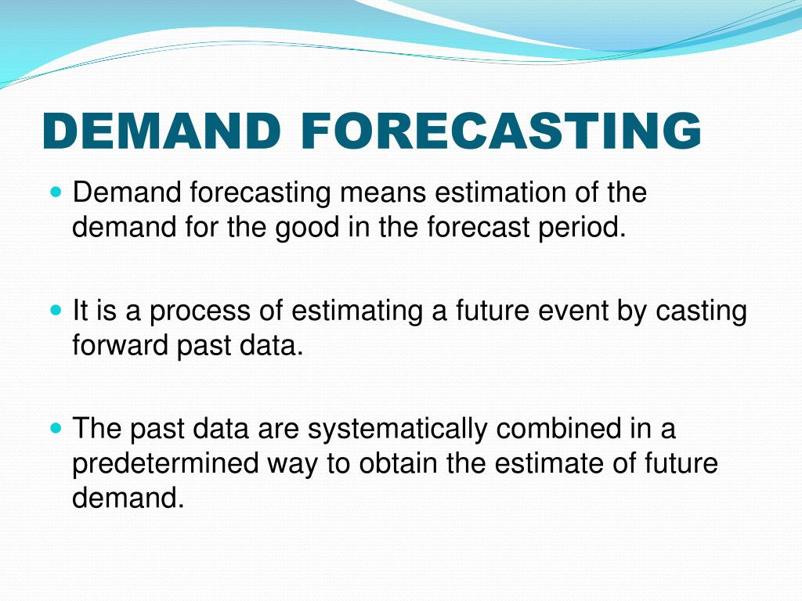

Slide 3
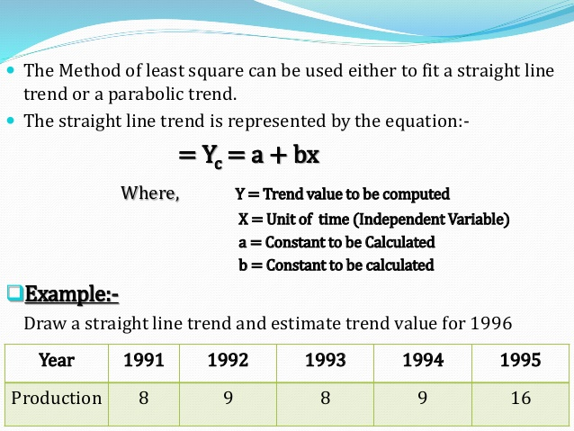
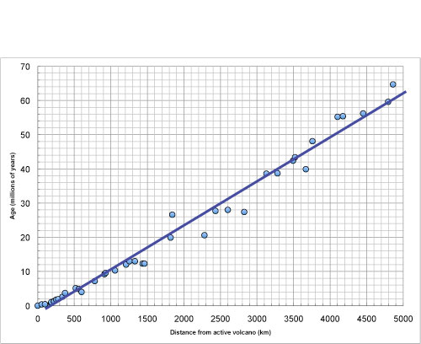
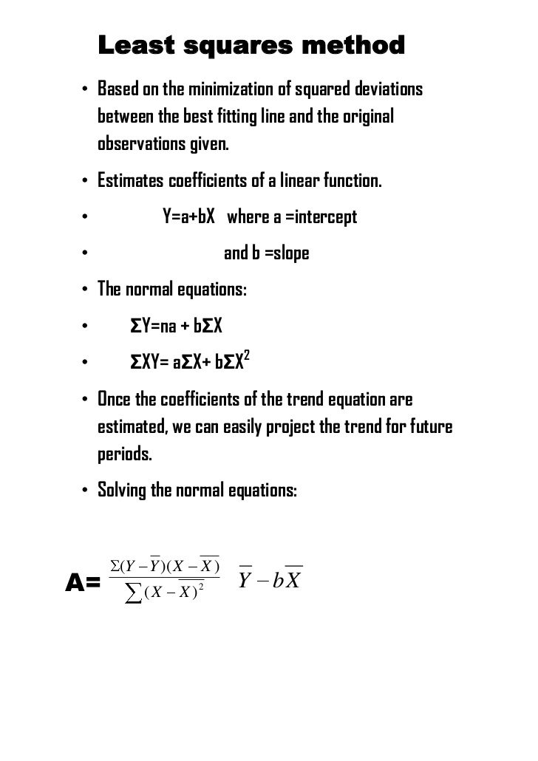

Slide 4
Forecast the sales for years 2005 and 2006 on the basis of the given data.
YEARS | SALES (Y)
1999 | 20
2000 | 40
2001 | 55
2002 | 70
2003 | 80

Slide 5
YEARS | SALES (Y) | X | X² | XY
1999 | 20 | -2 | 4 | -40
2000 | 40 | -1 | 1 | -40
2001 | 55 | 0 | 0 | 0
2002 | 70 | 1 | 1 | 70
2003 | 80 | 2 | 4 | 160
N=5 | 265 | 0 | 10 | 150
ΣY = Na +B ΣX
265 = 5a + 0
a = 53
ΣXY = a ΣX + B Σ x²
150 = a.0 + 10b
b = 15
Y= 53 +15 X (IN FORM OF Y =a +b X)
For year 2005,
X= 4 (2005-2001); Y(2005) = 53 + 15*4 = 113
For year 2006,
X = 5 (2006-2001); Y (2006) = 53 + 15*5 =128

Slide 6
Forecast the sales for years 2010 and 2012 on the basis of the given data.
YEARS | SALES (Y)
2002 | 40
2003 | 60
2004 | 75
2005 | 80
2006 | 100
2007 | 110
2008 | 115

Slide 7
YEARS | SALES (Y) | X | X² | XY
2002 | 40 | -3 | 9 | -120
2003 | 60 | -2 | 4 | -120
2004 | 75 | -1 | 1 | -75
2005 | 80 | 0 | 0 | 0
2006 | 100 | 1 | 1 | 100
2007 | 110 | 2 | 4 | 220
2008 | 115 | 3 | 9 | 345
N=7 | 580 | 0 | 28 | 350
ΣY = Na +B ΣX
580= 7a +0.b
a= 82.85
ΣXY = a ΣX + B Σ x²
350= a.0 +b. 28
b = 12.5
Y= 82.85 +12.5 X (IN FORM OF Y =a +bX)
For year 2010,
X= 5 (2010-2005); Y(2010) = 82.85 +12.5 * 5 = 145.35
For year 2012,
X = 7 (2012-2005); Y (2012) = 82.85 +12.5 * 7 = 170.35

Slide 8
Forecast the sales for years 1997 and 2000 on the basis of the given data.
YEARS | SALES (Y)
1990 | 20
1991 | 30
1992 | 35
1993 | 45
1994 | 60
1995 | 70

Slide 9
YEARS | SALES (Y) | X | X² | XY
1990 | 20 | -2.5 | 6.25 | -50
1991 | 30 | -1.5 | 2.25 | -45
1992 | 35 | -0.5 | 0.25 | -17.5
1993 | 45 | 0.5 | 0.25 | 22.5
1994 | 60 | 1.5 | 2.25 | 90
1995 | 70 | 2.5 | 6.25 | 175
N= 6 | 260 | 0 | 17.5 | 175
ΣY = Na +B ΣX
260= 6a +0.b
a= 43.33
ΣXY = a ΣX + B Σ x²
175= a.0 +b. 17.5
b = 10
Y= 43.33 +10 X (IN FORM OF Y =a +b X)
For year 1997,
X= 4.5 (1997-1992.5); Y(1997) = 43.33 +10 * 4.5 = 88.33
For year 2000,
X = 7.5 (2000-1992.5); Y (2000) = 43.33 +10 * 7.5 = 118.33

Slide 10
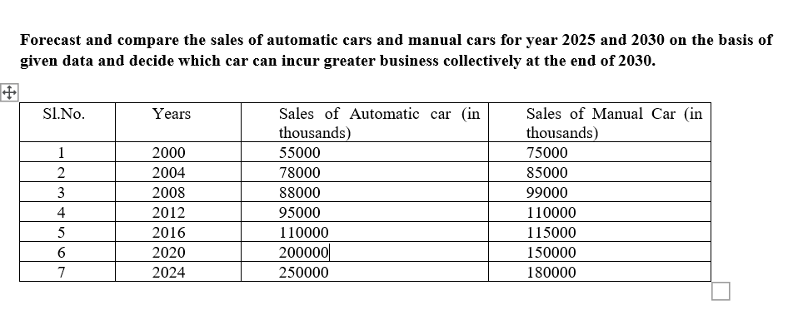

Slide 11
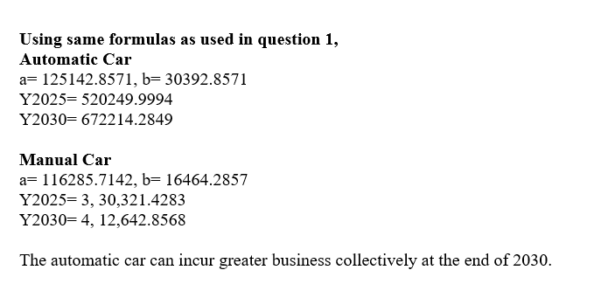

Slide 12
Given the following information about Income(X)per month and quantity demanded (Y), predict the Qd if the income is given as Rs. 50 per month, using Least Square method of demand forecasting.
Month | 1 | 2 | 3 | 4 | 5 | 6 | 7 | 8
Y | 20 | 30 | 35 | 20 | 25 | 37 | 45 | 28
X | 10 | 20 | 30 | 40 | 45 | 35 | 40 | 47

Slide 13
a= 24.89…. 26.528 =25-27(approx.)
slope=b=0.153…. 0.104
At X=Rs 50, Y = 30…33 units

Slide 14
Year | Sales
7 years back | 125
6 years back | 128
5 years back | 133
4 years back | 135
3 years back | 140
2 years back | 141
1 year back | 143

Slide 15
a= 135, b=3.1071
Y= 135+ 3.1071X
Y= 147.43

Slide 16

Thank You…

